Slide 1
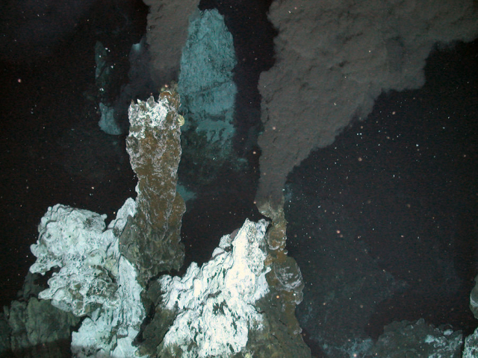





Seafloor massive sulphide (SMS) deposits
Iain Stobbs
PhD Student - SPITFIRE
University of Southampton
& National Oceanography Centre
Hydrothermal vent at depth 2.4 km in the Southern Ocean; (c) NERC ChEsSo Consortium

Slide 2
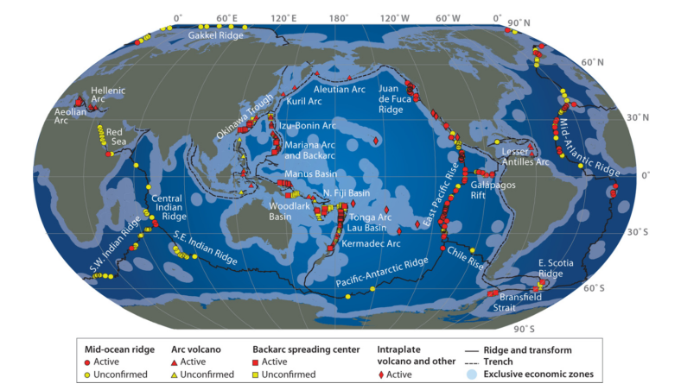
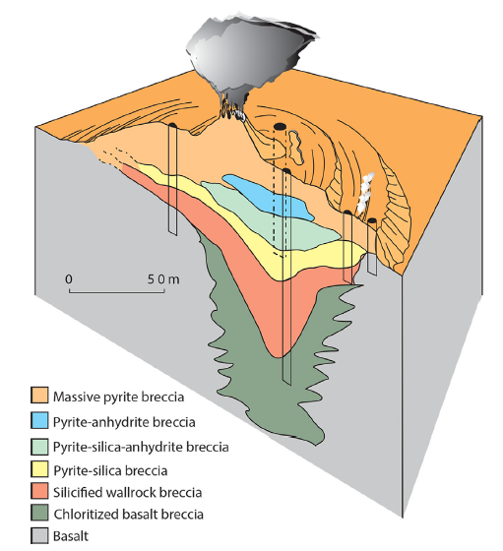
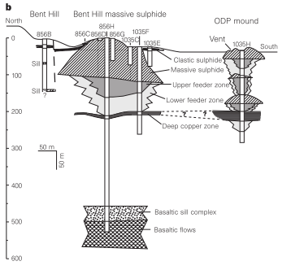
Hydrothermal Seafloor Massive Sulphides (SMS)
Middle Valley
TAG mound SMS
Medium spreading rate Juan de Fuca Ridge
Sediment rich system
Comparable to ‘Besshi type’ VMS deposits
Slow spreading Mid-Atlantic ridge
Low sedimentation rate
Multiple proven inactive vents within the TAG hydrothermal field
Comparable to ‘Cyprus type’ VMS deposits
Global distribution of hydrothermal vents (Hannington et al. 2011)
Located at or near ocean spreading ridges
Over 500 active hydrothermal venting systems discovered

Slide 3
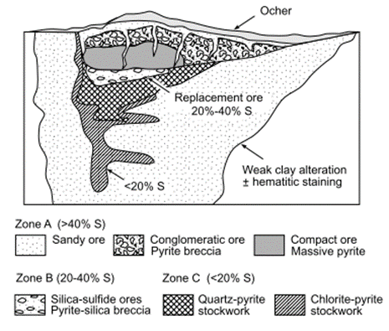
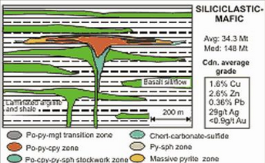
Comparing analogues?
TAG vs “Cyprus type”
Similar morphology
Similar formation processes
Similar geological setting
Middle Valley vs “Besshi-type”
Similar geological setting
Different morphology
However…
Ancient analogues often undergo significant metamorphism, which results in significant deformation and potential remobilisation of minerals

Slide 4
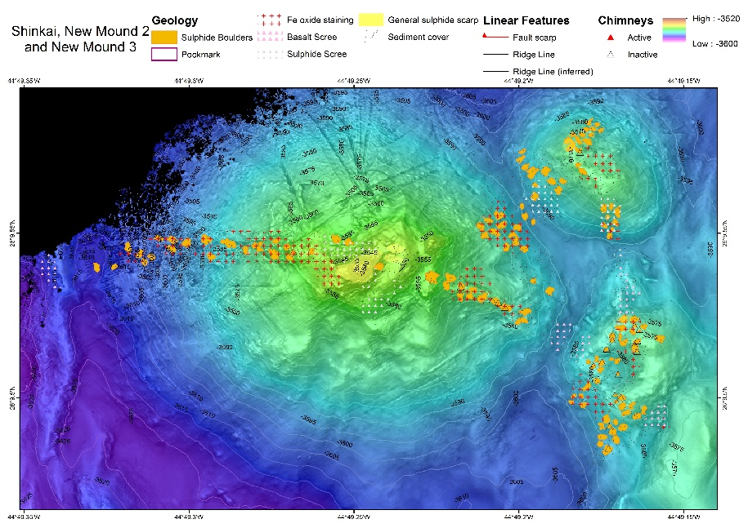
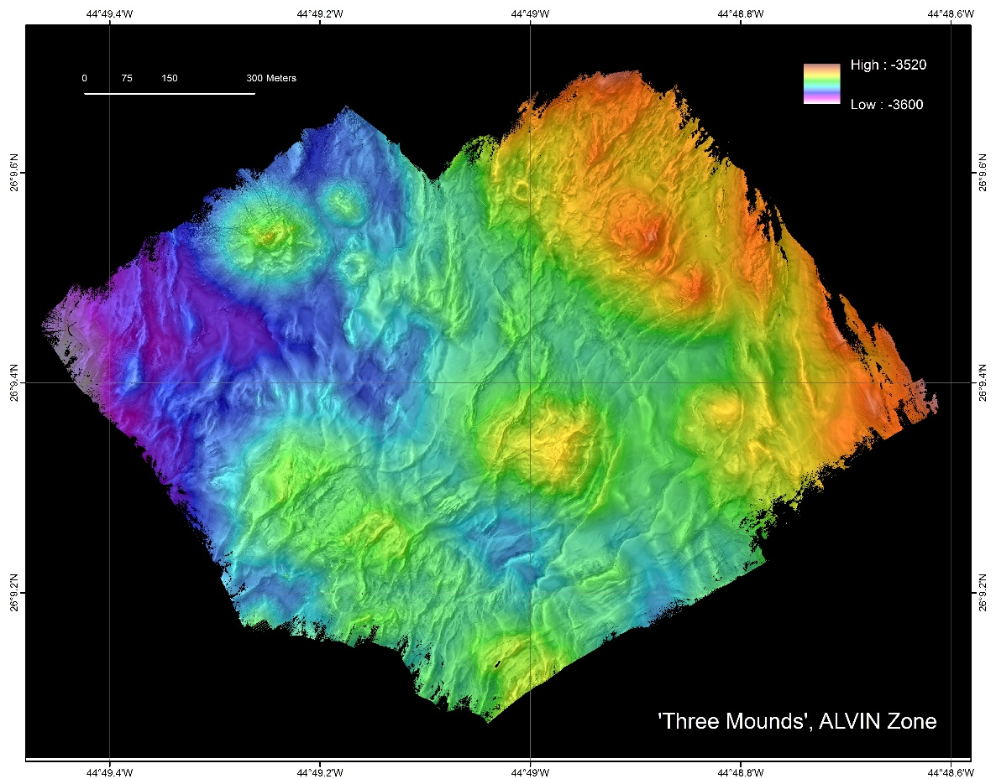
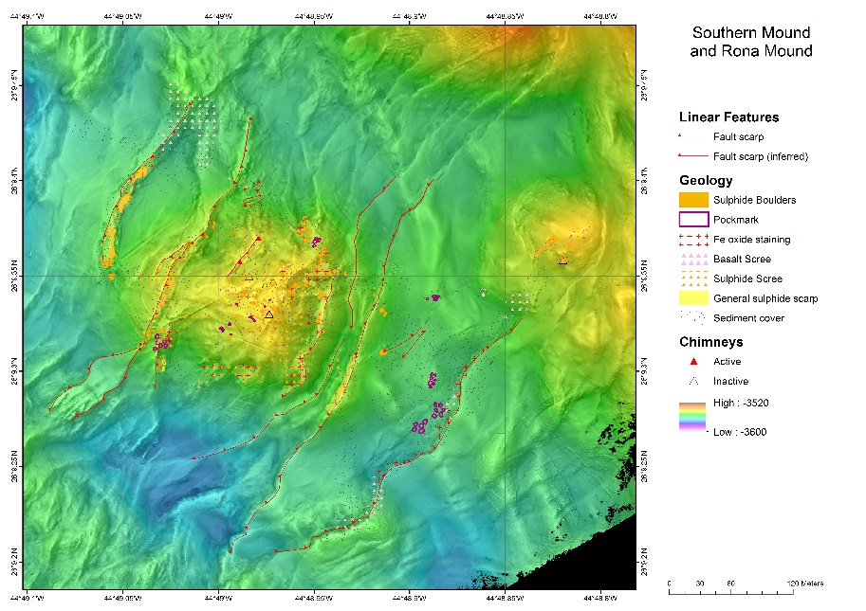
My Research Area – TAG hydrothermal field
Double Mound
Shinkai Mound
Southern Mound
-- 2 research cruises focusing on the inactive deposits along the TAG segment
- Obtained high resolution bathymetry (up to 0.5 m resolution), drilled three inactive hydrothermal mounds

Slide 5
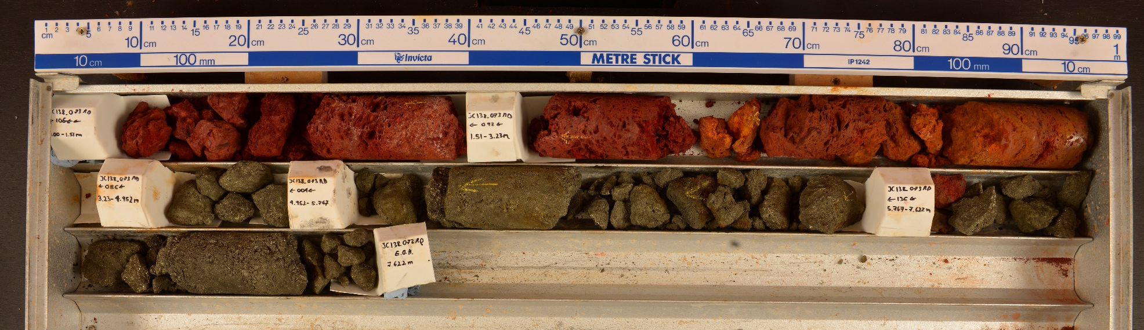
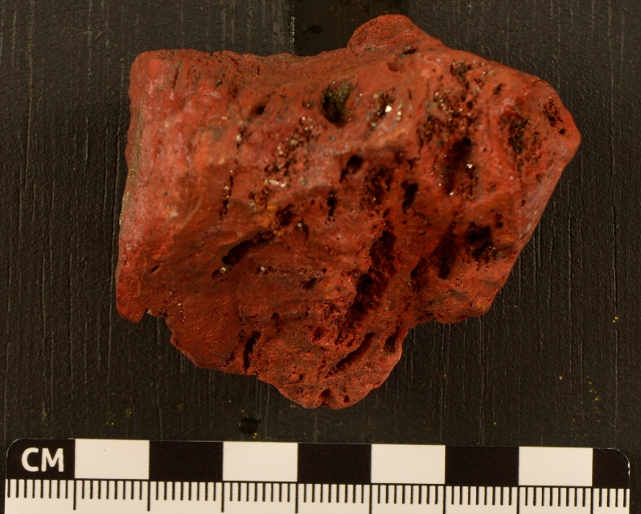
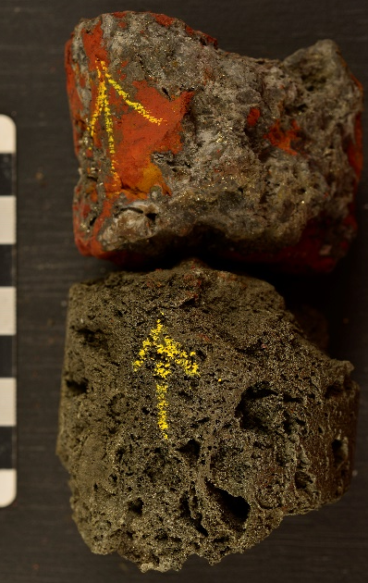
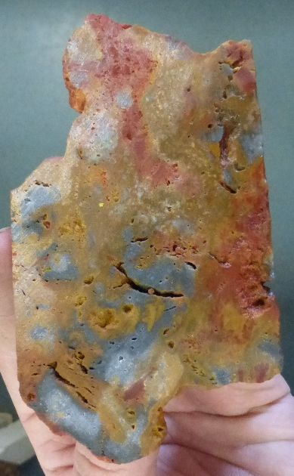
PhD Topic – A preserving cap?
Recovered of Jasper at three different inactive vent deposits
Variability of the sulphide and overlying jasper/Fe Ox interface
Focusing on the relationship between the sulphides and overlying jasper/Fe oxides

